Slide 1
Information meeting
for Year 4

Slide 2
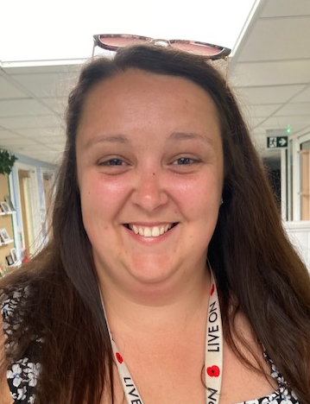
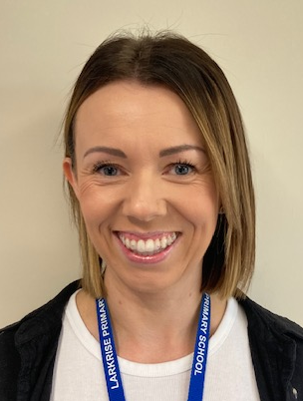
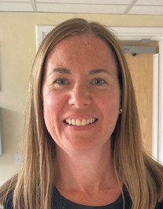
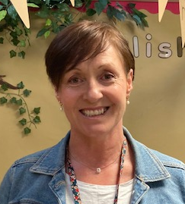
Our staffing team
Miss D Uzzell
Mrs C Winestein
Class teacher
Learning Support Assistant
Mrs N Finegold
Mrs C Tooze
Learning Support Assistant
Learning Support Assistant

Slide 3
Curriculum Overview

Slide 4
01
Ancient Greece
02
Out of this world
Long Term Curriculum
(Topics)
Let’s Rock!- The Stone Age
03
04
Ancient Egyptians

Slide 5
Addition and subtraction
Place value
Maths
Measure- Area
Multiplication and division
Religious and Philosophy
Electricity
This Term’s Curriculum
Wider Curriculum
Spanish
Ancient Greece
Torches
Greek vases
Add to Text
Creating and inventing
Mamma Mia
Greek foods

Slide 6
Good attendance means 97%+ over a year.
Government guidelines are for children’s attendance to be 95% and above.
Below 95% becomes a cause for concern and at 90% or below the child is considered to be ‘persistently absent’
Poor attendance triggers:
1) A letter informing you of your child’s attendance
2) The need to provide medical evidence for any absence and fines to be applied
3) The referral to the local government’s Educational Welfare Officer.
In addition to academic concerns, low attendance impacts on your child’s ability to build friendships. Children want to be friends with those children who they know they will see at playtime.
Attendance

Slide 7
This term our PE units will be Basketball and gymnastics.
Our PE days will be Monday and Wednesday. (Changes may occur due to potential external providers running PE sessions- this will be communicated via Dojo.)
Children will now be changing at school for PE so please ensure their PE kits are in school every day. These will be sent home fortnightly to be washed.
Please ensure that they are wearing white tops, black/navy shorts, socks, trainers or plimsolls. In colder weather, the children will be able to wear a plain black or navy tracksuit.
As usual, long hair needs to be tied back and earrings removed before coming to school.
PE

Slide 8
As a school we follow a programme for our Personal, Social, Citizenship and Health Education (PSHCE) called Jigsaw.
This is taught in every class, every week and links to assembly themes.
The Jigsaw themes for this year will be:
Being me in my World
Celebrating difference
Dreams and goals
Healthy me
Relationships
Changing me
Jigsaw
(PSHCE)

Slide 9
It is important to ensure your child is practising their times tables daily. This can be 10-15 minutes before school or after school. By the end of this year, they should know all their times tables up to 12x tables.
This is because at the end of Year 4 the children will take the Multiplication Tables Check (MTC).This is an on-screen assessment designed to determine whether pupils can fluently recall their multiplication tables up to 12. Children will have to answer 25 questions, each lasting 6 seconds. More information regarding this will be given out nearer to the time.
In school we will be regularly learning our times tables through the following methods:
- Early morning times tables tasks.
- Focusing on a specific times tables for 2 weeks.
- Weekly times tables tests.
- Learning times tables through song and rhymes.
- Using Times Tables Rockstars (TTRS) in class.
What you can do at home to support this:
- Ensure children are practising their times tables daily for 10-15 minutes.
- Ask them random questions whilst cooking dinner or on the way to school
- Using TTRS or playing times tables games
or using the following website.
https://www.themathsfactor.com/times-tables-check/pinpoint/#/
Times Tables

Slide 10
Reading for ten to fifteen minutes every day is expected. This should be recorded in the reading record with a comment from parents and signed.
Children’s reading will be monitored. In school, the reading your child will do will include:
Phonics/spelling lessons
Whole class shared reading
Reading comprehension practice
Reading in other subjects
Reading one-to-one with an adult
OTTER Time- reading for pleasure.
Reading records must be in school daily to record this and for the teacher/LSA to check home reading.
Children will be responsible for changing their own reading books. These can be changed as soon as they have finished their book.
Reading

Slide 11
Our school is increasing its focus on healthy lifestyles this year and there are some rules that will be in place.
Playtime snacks must be a piece of fruit or veg (not snack bars or chocolate).
Children will not be allowed to bring in sweets on their birthday, this is because:
It is our aim to promote healthy choices at school
We know that some parents feel under pressure to provide cakes/sweets for the whole class on their child’s birthday.
Wearing a birthday badge for the day might be a nice way of showing their friends it is their birthday.
Healthy schools

Slide 12
How do we assess the children?
Children are assessed across all subjects but particularly reading, writing and maths.
In Maths, children are assessed at the end of every teaching block with 20 questions linked to the area they have learnt. Children are also assessed at the end of every term using the Progress in Understanding Mathematics Assessment (PUMA). The scores create a standardised score to identify if children are working below, at age related expectations or greater depth.
In Reading, children are assessed every half term to see whether they are ready to move onto the next coloured banding. Children are also assessed at the end of every term using the Progress in Reading Assessment (PIRA). The scores create a standardised score to identify if children are working below, at age related expectations or greater depth.
Children are assessed on their independent pieces of writing across English and subjects such as History, Geography and Science. Teachers use writing criteria to check children’s writing skills across composition (purpose or audience), grammar, punctuation and transcription (spelling and handwriting.)
Assessment
12

Slide 13
Mrs Hawkins is our Deputy Headteacher and Special Educational Needs co-ordinator.
If your child does not seem to be making the progress we would expect, then additional steps may need to be put into place in order to help them access the curriculum and make good progress from their starting points.
Children who require this support in addition to what they receive in the classroom will have a ‘One Plan’ outlining what they need to work on, both in and outside of school to help them make good progress.
For more significant needs, a child may have an ‘Education, Health and Care Plan’ (EHCP).
This process is always done in consultation with a child’s parents and class teacher.
Special Educational Needs and or Disabilities
(SEND)

Slide 14
Mrs Pointon is our Child and Family Support Worker.
Her role is to be a ‘learning mentor’ to support children to do the best in their learning and also as a link between families and the school.
She already loves Larkrise children and we are really glad to have her here for 2.5 days a week.
Mrs Pointon is also in charge of The Parent Hub. Here you can access support through coffee mornings, access training programmes and use the preloved uniform shop in The Parent Hub.
Family support worker and The Parent Hub

Slide 15
If you have any questions/queries regarding your child/ren, their work or homework, please find me for a brief chat on the playground after school or message me via Dojo.
If you need more of my time to discuss things further then a separate appointment will need to be made.
Questions

