Slide 1
Supporting Your Child
Maths in EYFS and Key Stage One

Slide 2
The following ‘Top Tips’ are taken from: https://www.nationalnumeracy.org.uk/helping-children-maths

Slide 3


Slide 4
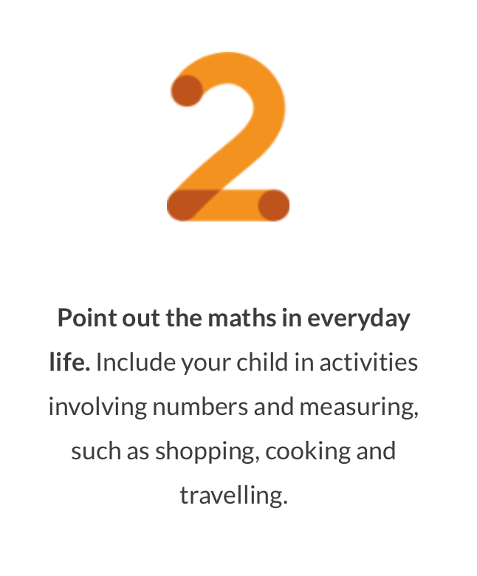

Slide 5


Slide 6
Some key concepts covered by our maths scheme with ideas to help you support your child at home.

Slide 7
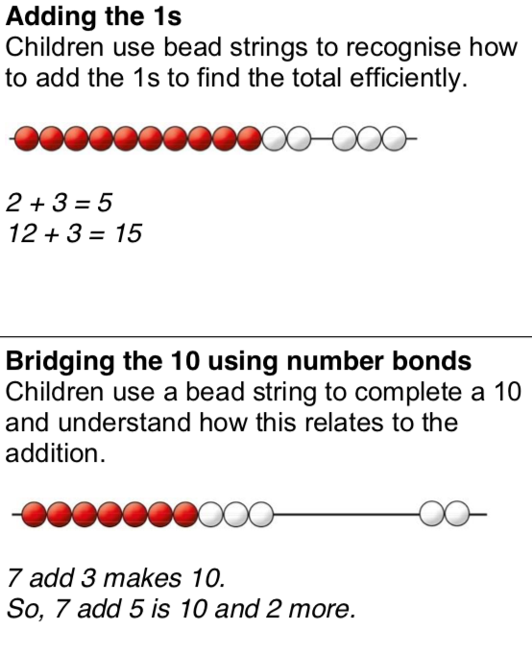
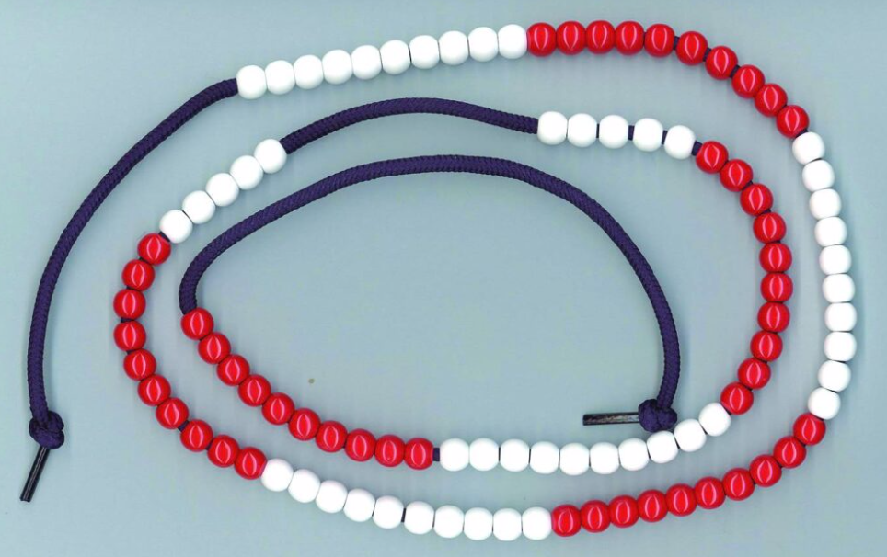
Bead Strings are made up of 100 beads, grouped in 10s. They can be moved up and down the string to help children see how numbers can be manipulated. These are relatively inexpensive, or you could make your own.

Slide 8
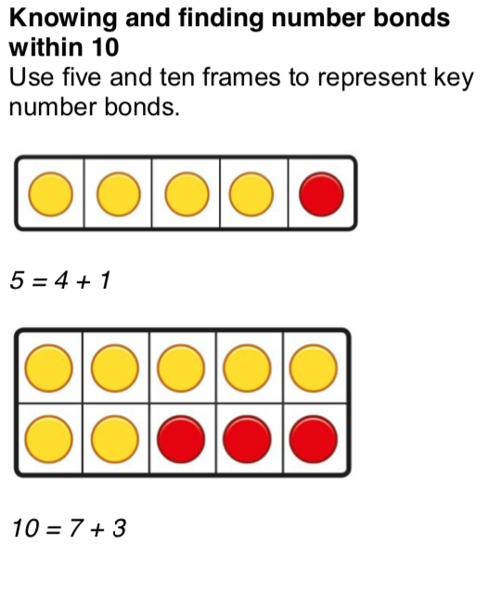

Slide 9
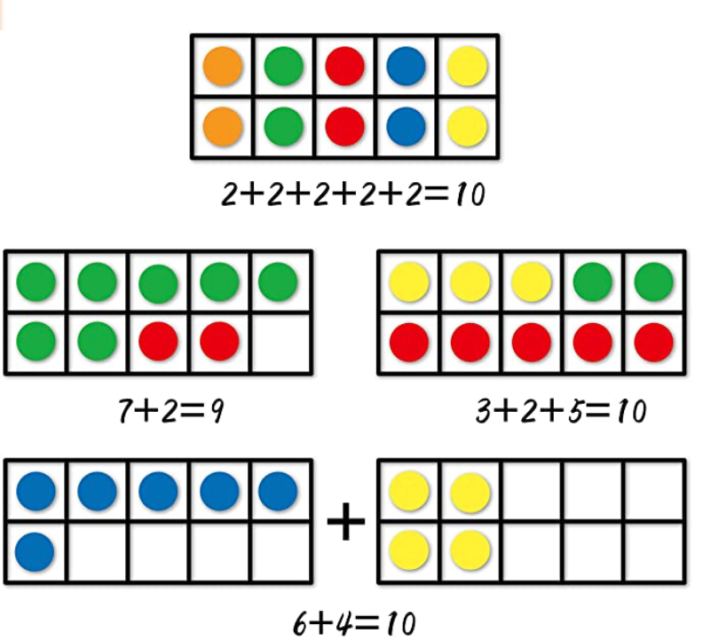

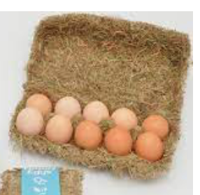
Ten Frames help children develop a mental picture of how ten is made. Children can use this knowledge to then add numbers beyond ten. A ten egg box could be a useful resource to have at home – you could use any small objects as counters.

Slide 10
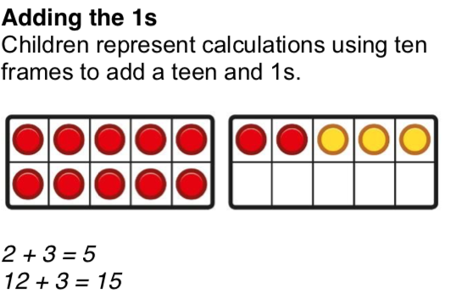

Slide 11
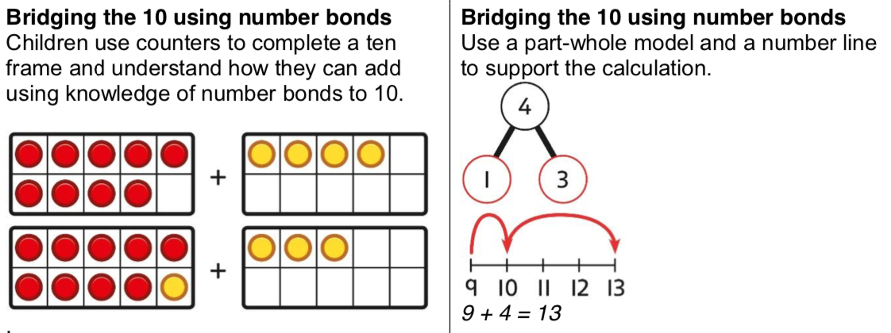

Slide 12
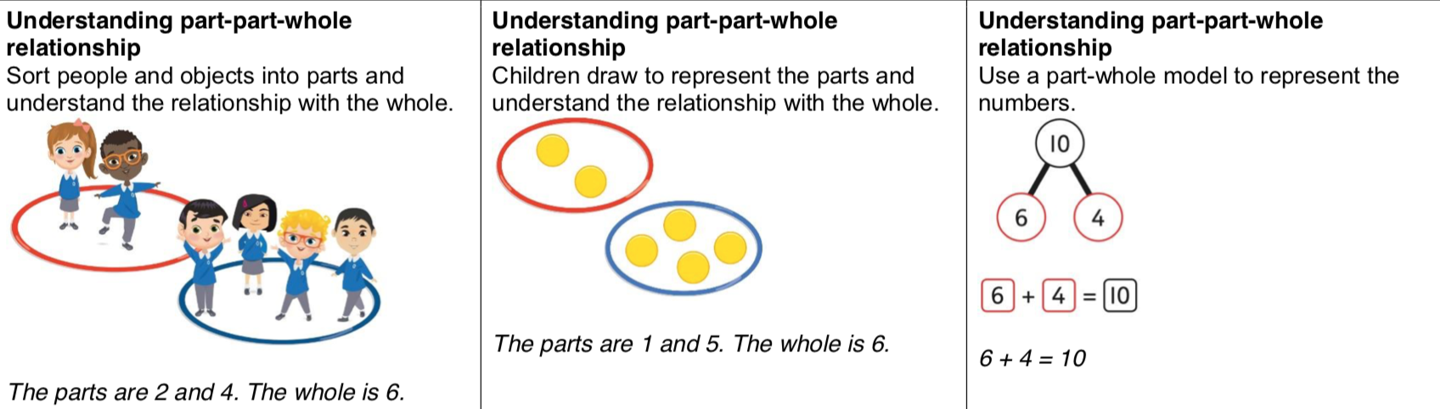
You may here your children refer to a ‘Part-Whole Model’. This is a way of representing the idea that all numbers can be broken down in different ways. Using this knowledge helps children to add and subtract.
Concrete
Pictorial
Abstract
The parts are two and four.
The whole is six.

Slide 13
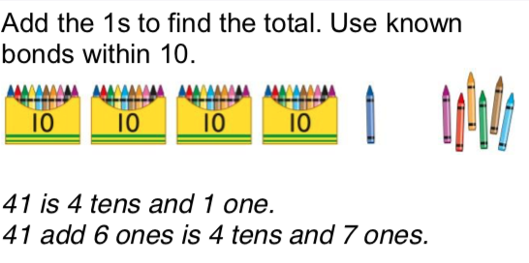
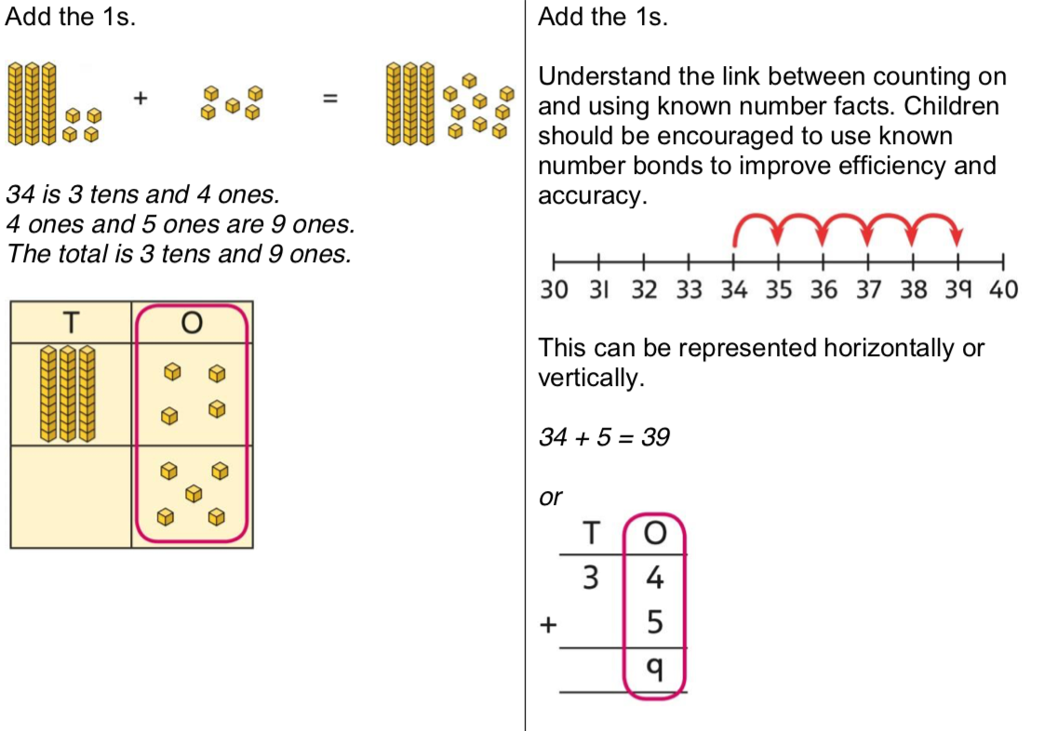
Pictorial
Abstract
Concrete
*Encourage children to use physical objects to represent numbers to help give their maths meaning
*Move to drawn objects to represent real world items
*Replace drawn objects with numbers

Slide 14
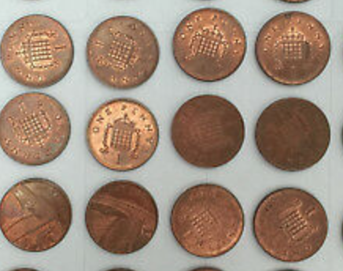



Multiplication
Counters are really helpful when doing maths at home – you don’t need to buy resources; 1p coins will do the job!
These coins are arranged in an ARRAY
This arrangement helps children see
that 3 lots of 4 make 12.

Slide 15




Multiplication
Counters are really helpful when doing maths at home – you don’t need to buy resources; 1p coins will do the job!
These coins are arranged in an ARRAY
This arrangement helps children see
that 3 lots of 4 make 12.
We can also see that 4 lots of 3 is 12.
(This is known as commutativity)

Slide 16
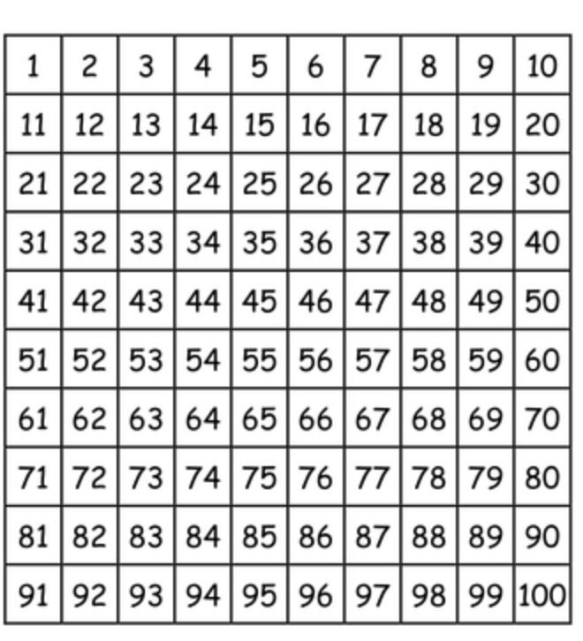

Times Tables
By the end of year 2, children should know their:
2
5
and
10
times tables.
Practising these at home really helps children to become secure in these number facts.
Colouring numbers on a 100 square helps children to see the patterns developing.

Slide 17
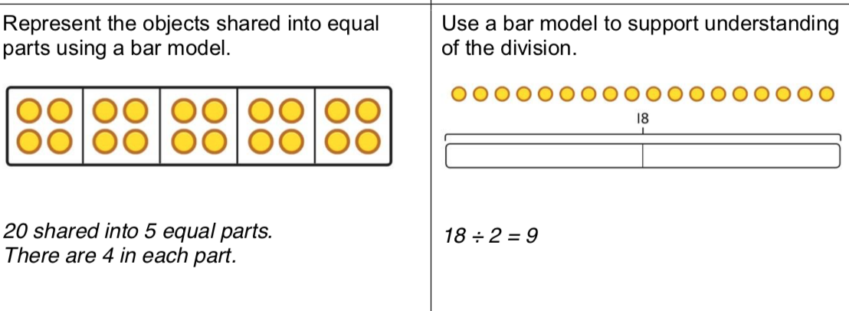
Division
We can use counters in a bar model to help children understand division as sharing or grouping. At home, 1p coins would work well if your child needs to do this practically.

Slide 18
Power Maths is the scheme we use for maths lessons at Larkrise
Each lesson is divided up into:
A Power Up activity designed to support fluency in all key number facts.
A Discover and Share activity where children can share, reason and learn.
Children then consider solutions as a class, with partners and independently.
Children then get the chance to practise the skills learnt to build fluency and develop deeper understanding of mathematical concepts. Challenge questions link to other areas of maths and encourage children to take their understanding to a greater level of depth.
Children review, reason and reflect on learning to end the lesson.

Slide 19

Morning Maths and Weekly Arithmetic Tests
Each morning when the children come into the classroom there is a Morning Maths activity linked to the arithmetic skill they are focusing on that week.
Arithmetic skills vary from basic addition and subtraction, multiplication and division and fractions of an amount for KS1.
Then once the children have learnt these skills they have a weekly arithmetic test to practise these skills. Scores are recorded and tracked by the class teachers and Maths Lead- Miss Uzzell who then uses this information to inform any additional support that might be needed.

Slide 20
Key Stage One Maths Tests
SATs at Key Stage One include two papers: one arithmetic and one for mathematical reasoning
Children complete these at their own pace - usually about fifteen minutes for paper one and thirty minutes for paper two

Slide 21
Calculation policies
All copies of our Calculation Policies in line with our Power Maths scheme can be found on our school website.
Head to Key Information and then click Policies and Guidance.
All policies for KS1, lower KS2 and Upper KS2 are found here.
https://www.larkrise.essex.sch.uk/policies-and-guidance/

Slide 22
Any Questions?

