Slide 1

Information meeting
for Reception

Slide 2

Mrs L Lane
Mrs S Charlick
Our staffing team
Class teacher
Learning Support Assistant
All day
Mrs Murphy
PPA cover
Mrs K Morton
Mrs C Touze
Learning Support Assistants
AM

Slide 3
Please name EVERYTHING!
At this age, children find it hard to keep track of their belongings. Having a name on an item will help us return it to you much quicker!
Children only need their blue school bookbag, water bottle and lunch box (if not school dinner). We do not have space for lots of backpacks and they are not needed. If your child needs spare clothes, please send these in a named plastic bag and we will store them separately.
Key Information

Slide 4
At Larkrise, we take pride in our uniform.
In reception, the children are expected to wear the following:
A white polo shirt
Royal blue Jumper/sweatshirt
Black or grey trousers/joggers
Grey skirt or dress
Blue summer dress in Summer term (possibly Autumn term until October if weather permits)
Black shoes (Velcro would be ideal!)
Ties are from Year 1 onwards.
Uniform

Slide 5
In Reception we will still go outside when it is cold and damp. So we will need each child to bring in a named pair of wellies that will remain in school.
It is also a good idea to send your child in with a waterproof jacket or coat every day. The weather in this country is very changeable so it is best to be prepared!
Uniform

Slide 6
Good attendance means 97%+ over a year.
Government guidelines are for children’s attendance to be 95% and above.
Below 95% becomes a cause for concern and at 90% or below the child is considered to be ‘persistently absent’
Poor attendance triggers:
1) A letter informing you of your child’s attendance
2) The need to provide medical evidence for any absence and fines to be applied
3) The referral to the local government’s Educational Welfare Officer.
In addition to academic concerns, low attendance impacts on your child’s ability to build friendships. Children want to be friends with those children who they know they will see at playtime.
Attendance

Slide 7
Our school is continuing its focus on healthy lifestyles this year and there are some rules that will be in place.
Children will be provided with a piece of fruit during morning snack time. They will also be offered milk.
Children are not allowed to bring in sweets on their birthday, this is because:
It is our aim to promote healthy choices at school
We know that some parents feel under pressure to provide cakes/sweets for the whole class on their child’s birthday.
Wearing a birthday badge for the day might be a nice way of showing their friends it is their birthday.
Healthy schools

Slide 8

Curriculum Overview

Slide 9
The Autumn Term
This term our topic will be Marvellous Me!
The children will be learning about their feelings and emotions.
They will be learning about their families and where they live.
They will be learning new routines and how to ask for help.
They will be building relationships both with the adults in the classroom and their peers.
Curriculum
0

Slide 10
The Autumn Term
We will be starting to learn Phonics
We will also be learning numbers and counting.
Reading stories and singing songs will be something we do on a daily basis.
The Early Years Curriculum covers the following areas
Communication and Language
Literacy
Physical development
Mathematics
Understanding the world
Personal, social and emotional
Expressive arts and design
And every thing we do will be linked to these areas and the children will be assessed in the Summer term in each of these areas.
Curriculum
0

Slide 11
Reading for ten to fifteen minutes every day is expected and will make a real difference especially in the early stages. This should be recorded in the reading record with a comment from parents and signed.
We will begin by sending home story books that can be shared together and will be changed regularly.
Children’s reading will be monitored. In school, the reading your child will do will include:
Phonics lessons
Whole class shared reading
Reading one-to-one with an adult
Reading for pleasure
Sharing a class story for fun!
Reading records must be in school daily to record this and for the teacher/LSA to check home reading.
Reading

Slide 12
As a school we follow a programme for our Personal, Social, Citizenship and Health Education (PSHCE) called Jigsaw.
This is taught in every class, every week and links to assembly themes.
The Jigsaw themes for this year will be:
Being me in my World
Celebrating difference
Dreams and goals
Healthy me
Relationships
Changing me
Jigsaw
(PSHCE)

Slide 13
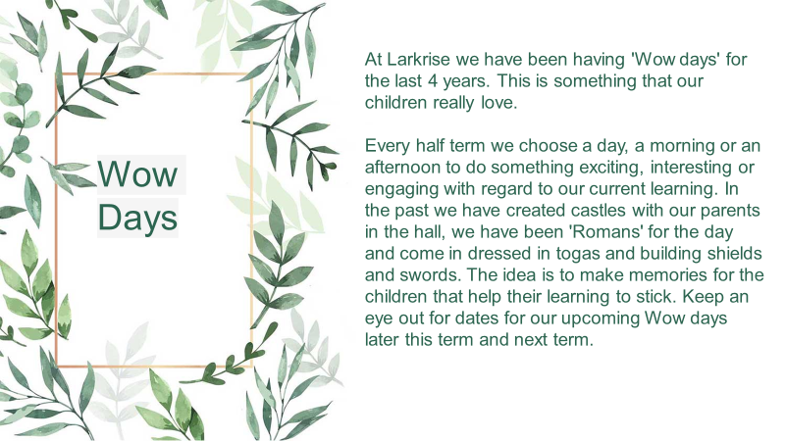

Slide 14
Our PE day will be Thursday to begin with.
Children will get changed at school for PE so please ensure their PE kits are in school.
Please ensure that they have a white top, black/navy shorts, socks, trainers or plimsolls. In colder weather, the children will be able to wear a plain black or navy tracksuit.
As usual, long hair needs to be tied back and earrings removed before coming to school.
PE

Slide 15
Mrs Maggie Pattullo is our Special Educational Needs co-ordinator. m.pattullo@larkrise.essex.sch.uk
If your child does not seem to be making the progress we would expect, then additional steps may need to be put into place in order to help them access the curriculum and make good progress from their starting points.
Children who require this support in addition to what they receive in the classroom will have a ‘One Plan’ outlining what they need to work on, both in and outside of school to help them make good progress.
For more significant needs, a child may have an ‘Education, Health and Care Plan’ (EHCP).
This process is always done in consultation with a child’s parents and class teacher.
Special Educational Needs and or Disabilities
(SEND)

Slide 16
Our Family Support Worker is Mel Pointon. She is one of our Safeguarding leads and also a member of the senior leadership team. Her role is to support children and families, helping to make sure that every child feels safe, listened to and supported both at school and at home.
She is trained in play therapy and counselling skills, and can support children in school through sand/play therapy, Draw and Talk, Bereavement Toolbox or simply by providing a safe space and a listening ear when they need someone to talk to.
A large part of Mel's job is supporting the parents when needed, she is experienced in supporting whatever life throws at you! To give you an idea here is a short list:
Family separation and changes within the family
Domestic abuse support
Foodbank vouchers
TPP (Trauma, Parenting and Partnership) workshops for families
Behaviour support
Helping with referrals to external agencies and services
You can meet with Mel in The Hive, a welcoming space away from the main school building where you can talk confidentially and feel at ease.
The Hive is also home to our pre-loved uniform shop, offering good-quality school uniform at a lower cost for families.
Contact Mel whether you need advice, practical support, someone to listen, or help finding the right service for your family. You don’t have to wait until a problem becomes overwhelming.
Family support worker and The Hive

Slide 17
If you have any questions/queries regarding your child/ren or what is happening in the classroom, please catch me for a brief chat after school or message me via Dojo.
Please also see our Communication Policy which outlines the different ways you can contact us at school and which ways are most appropriate for different scenarios.
If you need more of my time to discuss things further, then a separate appointment will need to be made.
Questions

