Slide 1

Information meeting
for Year 1

Slide 2

Mrs Bacon
- Class teacher
Ms Moule
Miss Carline
Learning Support Assistant
Our team
Mrs Murphy - PPA cover

Slide 3
Katie Allen – Headteacher DSL
Mel Pointon – DDSL Family Support worker
Phil Alcock – DDSL Year 6 teacher
SENDCO - Mrs Maggie Pattullo M.Pattullo@larkrise.essex.sch.uk
Our Senior Leadership Team

Slide 4
Why is important you know about your child’s teacher?
I will spend a considerable amount of time with your child. I will nurture and teach your child through their year 1 learning.
This is my twentieth year in Education.
I am a mum of four daughters. I am A SEND mum.
I foster a nurturing, firm and fair ethos in my classroom. Each child will be listened to and respected for who they are.
Google tells me I am officially a crazy cat lady!
I love leopard print.
Mrs Bacon

Slide 5
We promote kindness, empathy for others and polite manners.
We work as a class family looking out for each other.
I see my job as not only to teach Maths and English but to help create delightful human beings.
In our class

Slide 6

Year 1 Curriculum Overview

Slide 7
We are now learning the Key stage 1 Curriculum.
Year 1 is a more structured and formal way of learning when compared to EYFS. However, we are still have continuous provision style learning activities.
Each day will consist of Maths lesson, English lesson, Phonics and two foundation subjects.
We will be introducing EWI – Early writing instruction which is a small oral rehearsal and writing lesson.
Key stage 1 Learning

Slide 8
English
Autumn Term Topic is:
Our Local Area
Toys
Simple sentence writing and grammar
Place value, addition and subtraction
Knowing all about our local area / Toys through time
Science: Everyday materials / seasons
Mixing colours, painting techniques / printing
RE
Music
computing
PE
D & T
Maths
Bears
and
Toys
History
Geography

Slide 9
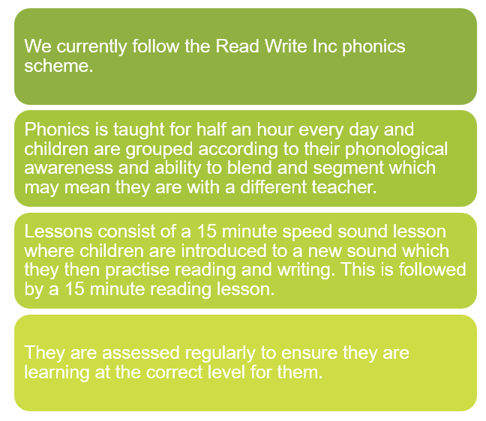
Phonics

Slide 10
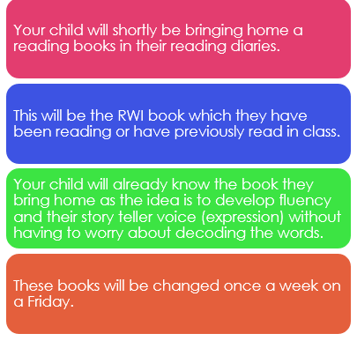
Phonics

Slide 11
Children’s reading will be monitored. In school, the reading your child will do will include:
Phonics/spelling lessons
Reading one-to-one with an adult
Group reading
Reading in other subjects
Reading for pleasure.
Sharing a class story for fun!
Reading records and reading books need to be in school each day.
Children can change their books more frequently when they finish their books,
Reading

Slide 12
In year 1 we have Common exception words. (a group of words that are commonly used)
Each term the children will learn a set of words and I will send home to practice at home of you wish.
Spelling

Slide 13
As a school we follow a programme for our Personal, Social, Citizenship and Health Education (PSHCE) called Jigsaw.
This is taught in every class, every week and links to assembly themes.
Jigsaw
(PSHCE)

Slide 14
Our PE days will be Tuesday and Wednesdays.
Children will continue to change at school for PE so please ensure their PE kits are in school.
Please ensure that they are wearing white tops, black/navy shorts, socks, trainers or plimsolls. In colder weather, the children will be able to wear a plain black or navy tracksuit.
Children will go outside for P.E even in the chilly weather.
As usual, long hair needs to be tied back and earrings removed before coming to school.
PE

Slide 15
Good attendance means 97%+ over a year.
Government guidelines are for children’s attendance to be 95% and above.
Below 95% becomes a cause for concern and at 90% or below the child is considered to be ‘persistently absent’
Poor attendance triggers:
1) A letter informing you of your child’s attendance
2) The need to provide medical evidence for any absence and fines to be applied
3) The referral to the local government’s Educational Welfare Officer.
In addition to academic concerns, low attendance impacts on your child’s ability to build friendships. Children want to be friends with those children who they know they will see at playtime.
Attendance

Slide 16
As a school we want to represent our community and our uniform enables us to do that proudly.
A uniform is a way for children to feel that they belong.
The introduction of our ties has smartened our uniform and has excited the children.
We ask all parents to follow the uniform policy which can be found on our website.
Uniform

Slide 17
We have worked as a class to come up with our class expectations.
The children also decided on consequences if our expectations are not followed.
These expectations follow our behaviour policy which you will find on our website.
Behaviour and class expectations

Slide 18
At Larkrise we have been having 'Wow days' for the last 4 years. This is something that our children really love.
Every half term we choose a day, a morning or an afternoon to do something exciting, interesting or engaging with regard to our current learning. In the past we have created castles with our parents in the hall, we have been 'Romans' for the day and come in dressed in togas and building shields and swords. The idea is to make memories for the children that help their learning to stick. Keep an eye out for dates for our upcoming Wow days later this term and next term.
Wow Days

Slide 19
In year 1, Children complete the phonics screening check in June. Children who do not pass this will be given the opportunity to re sit this in Year 2.
Phonics Assessment Test

Slide 20
At Larkrise we do not set formal homework.
What we do ask is to read with your child every night.
This will help them become confident and fluent readers.
Being a confident reader enables them to access all areas of the curriculum and develop a love for reading for life.
When reading at home please sign the reading diary each time you read with your child.
Homework

Slide 21
Our school is increasing its focus on healthy lifestyles this year and there are some rules that will be in place.
Playtime snacks must be a piece of fruit or veg (not snack bars or chocolate).
Children should not bring in sweets on their birthday, this is because:
It is our aim to promote healthy choices at school
We know that some parents feel under pressure to provide cakes/sweets for the whole class on their child’s birthday.
Wearing a birthday badge for the day might be a nice way of showing their friends it is their birthday.
Healthy schools

Slide 22
Mrs Maggie Pattullo is our Special Educational Needs co-ordinator.
If your child does not seem to be making the progress we would expect, then additional steps may need to be put into place in order to help them access the curriculum and make good progress from their starting points.
Children who require this support in addition to what they receive in the classroom will have a ‘One Plan’ outlining what they need to work on, both in and outside of school to help them make good progress.
For more significant needs, a child may have an ‘Education, Health and Care Plan’ (EHCP).
This process is always done in consultation with a child’s parents and class teacher.
Special Educational Needs and or Disabilities
(SEND)

Slide 23
Our Family Support Worker is Mel Pointon. She is one of our Safeguarding leads and also a member of the senior leadership team. Her role is to support children and families, helping to make sure that every child feels safe, listened to and supported both at school and at home.
She is trained in play therapy and counselling skills, and can support children in school through sand/play therapy, Draw and Talk, Bereavement Toolbox or simply by providing a safe space and a listening ear when they need someone to talk to.
A large part of Mel's job is supporting the parents when needed, she is experienced in supporting whatever life throws at you! To give you an idea here is a short list:
Family separation and changes within the family
Domestic abuse support
Foodbank vouchers
TPP (Trauma, Parenting and Partnership) workshops for families
Behaviour support
Helping with referrals to external agencies and services
You can meet with Mel in The Hive, a welcoming space away from the main school building where you can talk confidentially and feel at ease.
The Hive is also home to our pre-loved uniform shop, offering good-quality school uniform at a lower cost for families.
Contact Mel whether you need advice, practical support, someone to listen, or help finding the right service for your family. You don’t have to wait until a problem becomes overwhelming.
Family support worker and The Hive

Slide 24
Our forms of Parent school of communication are:
Class Dojo – This an informal way of communicating with myself. I look at DoJo after school after seeing the children out.
Due to school commitments I cannot always check or respond immediately.
All important or urgent message especially messages that are time sensitive for example school collection arrangements.
If you need to speak to me then the office can advise of when the best time to see me.
To speak to the Headteacher pop in the office and speak to the office staff about arranging a convenient time.
Communication
For more information please see our Communication policy on our website.

Slide 25
Any questions?

