Slide 1

Information meeting
for Year 4

Slide 2

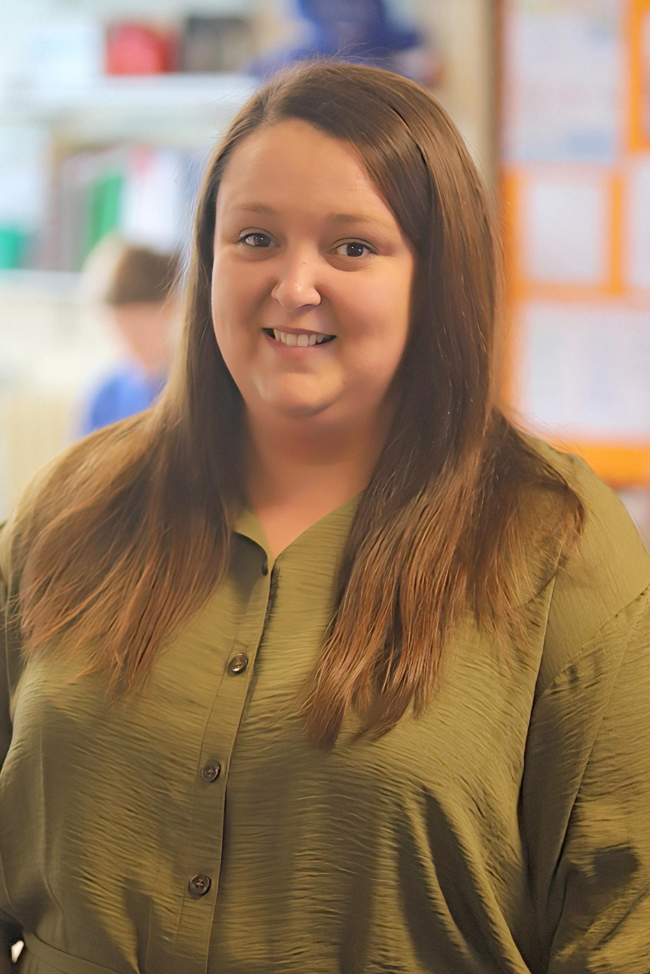
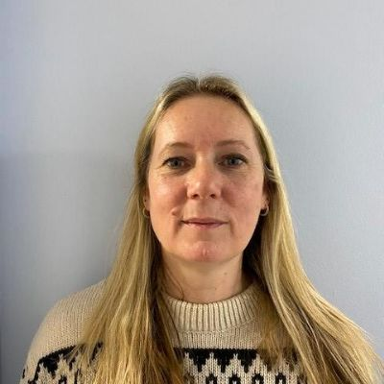
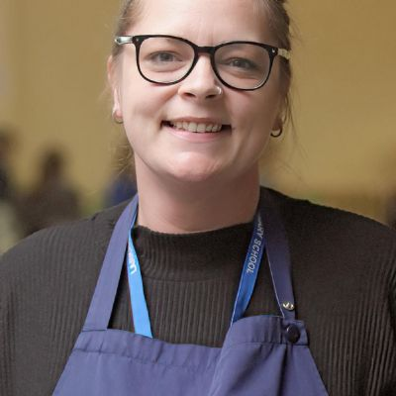
Our staffing team
Miss D Uzzell
Mrs V Elliot
Class teacher
Learning Support Assistant
Mrs L Collier
Mrs S Murphy
Learning Support Assistant
PPA Cover teacher

Slide 3

Curriculum Overview

Slide 4
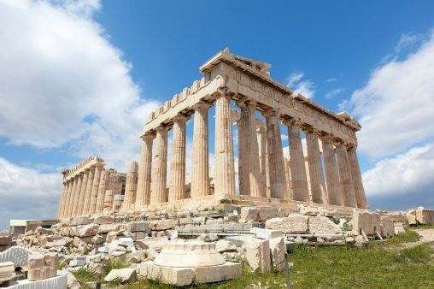
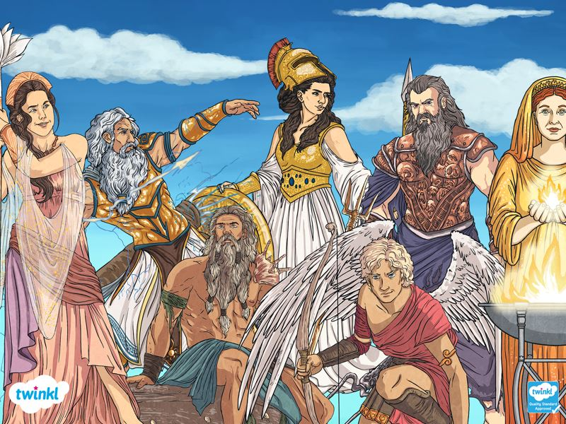

The Autumn Term
This term, we will be travelling back in time to explore Ancient Greece! The children will learn about what life was like for people living in Ancient Greece and discover how the Greeks have influenced the world we live in today.
We will explore Greek gods and mythology, democracy, the Olympic Games, Greek society, food and daily life, as well as the fascinating differences between Athens and Sparta.
The children will also develop their historical skills by using evidence from the past, comparing sources and placing events on a timeline, while making links between Ancient Greece and modern life.
Curriculum
(Topic)
0

Slide 5
Addition and subtraction
Place value
Maths
Area
Multiplication and Division
Electricity
Being Me
This Term’s Curriculum
Understanding our world
Christianity
Ancient Greeks
Banksy
Printing patterns
Add to Text
Creating and inventing
Mamma Mia
Hardware and software

Slide 6
Good attendance means 97%+ over a year.
Government guidelines are for children’s attendance to be 95% and above.
Below 95% becomes a cause for concern and at 90% or below the child is considered to be ‘persistently absent’
Poor attendance triggers:
1) A letter informing you of your child’s attendance
2) The need to provide medical evidence for any absence and fines to be applied
3) The referral to the local government’s Educational Welfare Officer.
In addition to academic concerns, low attendance impacts on your child’s ability to build friendships. Children want to be friends with those children who they know they will see at playtime.
Attendance

Slide 7
This term our PE units will be tennis and pilates.
Our PE days will be Tuesday and Wednesday. (This may change due to potential external providers running PE sessions- this will be communicated via Dojo.)
Children will change at school for PE so please ensure their PE kits are in school.
PE KIT
- Plain trainers (trainers for outside use and for sporting competitions)
Blue PE shorts
White T-shirt
Black/dark coloured, plain tracksuit for the winter months (for outside use)
As usual, long hair needs to be tied back and earrings removed before coming to school.
PE

Slide 8
As a school we follow a programme for our Personal, Social, Citizenship and Health Education (PSHCE) called Jigsaw.
This is taught in every class, every week and links to assembly themes.
The Jigsaw themes for this year will be:
Being me in my World (Goals, learning, safety).
Celebrating difference (Acceptance, bullying)
Dreams and goals (Teamwork, making a difference)
Healthy me (Drugs, exploitation, gangs)
Relationships (Mental health, love and loss)
Changing me (Self image, puberty)
Jigsaw
(PSHCE)

Slide 9
At Larkrise we have been having 'Wow days' for the last 4 years. This is something that our children really love.
Every half term we choose a day, a morning or an afternoon to do something exciting, interesting or engaging with regard to our current learning. In the past we have created castles with our parents in the hall, we have been 'Romans' for the day and come in dressed in togas and building shields and swords. The idea is to make memories for the children that help their learning to stick. Keep an eye out for dates for our upcoming Wow days later this term and next term.
Wow Days

Slide 10
We will be encouraging pupils to become more confident, independent, resilient and organised.
Therefore, children will be responsible for: - letters
reading records
changing reading books
homework
water bottles
PE kit
uniform
swimming kits- when this takes place in the Spring term.
Roles and responsibilities

Slide 11
This year the children will be bringing home homework that needs to be completed.
This will be:
- 10 to 15 minutes of reading everyday. Reading records need to be signed by you each time that they have read.
Times tables practice on TTRS.
Weekly spellings- children will be given 10 spellings to learn each week. They will then be tested on these the following week.
Homework will be handed out on a Friday.
Homework

Slide 12
Reading for ten to fifteen minutes every day is expected. This should be recorded in the reading record with a comment from parents and signed.
Children’s reading will be monitored. In school, the reading your child will do will include:
Phonics/spelling lessons
Whole class shared reading
Reading comprehension practice
Reading in other subjects
Reading one-to-one with an adult
Reading for pleasure.
Sharing a class story for fun!
Reading records must be in school daily to record this and for the teacher/LSA to check home reading.
Children will be responsible for changing their own reading books. These can be changed as soon as they have finished their book.
Reading

Slide 13
Please support your children with the work they are sent home with. This provides a solid base for their developing literacy and forms the foundation for ALL OTHER AREAS of the curriculum.
Spellings is an important part of the Year 4 curriculum. So, they need to practise their spellings homework.
This should be done using the strategy of Look, Say, Cover, Write and Check (LSCWC). Separate sheets for LSCWC can be provided if necessary.
Children also need to continue their revision of spelling patterns they have learnt in years 2 and 3.
Spelling

Slide 14
It is important to ensure your child is practising their times tables daily. This can be 10-15 minutes before school or after school. By the end of this year, they should know all their times tables up to 12x tables.​
​
This is because at the end of Year 4 the children will take the Multiplication Tables Check (MTC).This is an on-screen assessment designed to determine whether pupils can fluently recall their multiplication tables up to 12. Children will have to answer 25 questions, each lasting 6 seconds. More information regarding this will be given out nearer to the time. ​
​
In school we will be regularly learning our times tables through the following methods:​
- Early morning times tables tasks.​
- Focusing on a specific times tables for 2 weeks. ​
- Weekly times tables tests. ​
- Learning times tables through song and rhymes.​
Using Times Tables Rockstars (TTRS) in class. ​
Daily Fast Maths​
​
What you can do at home to support this:​
- Ensure children are practising their times tables daily for 10-15 minutes. ​
- Ask them random questions whilst cooking dinner or on the way to school​
- Using TTRS or playing times tables games ​or using the following website. ​
https://www.themathsfactor.com/times-tables-check/pinpoint/#/ ​
​
Times tables

Slide 15
Our school is increasing its focus on healthy lifestyles this year and there are some rules that will be in place.
Playtime snacks must be a piece of fruit or veg (not snack bars or chocolate).
Children will not be allowed to bring in sweets on their birthday, this is because:
It is our aim to promote healthy choices at school
We know that some parents feel under pressure to provide cakes/sweets for the whole class on their child’s birthday.
Wearing a birthday badge for the day might be a nice way of showing their friends it is their birthday.
Healthy schools

Slide 16
How do we assess the children?​
Children are assessed across all subjects but particularly reading, writing and maths. ​
​
In Maths, children are assessed at the end of every teaching block with 20 questions linked to the area they have learnt. Children are also assessed at the end of every term using White Rose’s end of term assessments for Arithmetic and Problem solving and reasoning. These scores along with data from weekly arithmetic test help teachers to assess whether pupils are working at age related expectations or greater depth. ​
​
In Reading, children are assessed every half term to see whether they are ready to move onto the next coloured banding. Children are also assessed at the end of every term using the Progress in Reading Assessment (PIRA). The scores create a standardised score to identify if children are working below, at age related expectations or greater depth. ​
​
Children are assessed on their independent pieces of writing across English and subjects such as History, Geography and Science. Teachers use writing criteria to check children’s writing skills across composition (purpose or audience), grammar, punctuation and transcription (spelling and handwriting.)​
Assessment
16

Slide 17
Mrs Pattullo is our Special Educational Needs co-ordinator. Her email address is m.pattullo@larkrise.essex.sch.uk
If your child does not seem to be making the progress we would expect, then additional steps may need to be put into place in order to help them access the curriculum and make good progress from their starting points.
Children who require this support in addition to what they receive in the classroom will have a ‘One Plan’ outlining what they need to work on, both in and outside of school to help them make good progress.
For more significant needs, a child may have an ‘Education, Health and Care Plan’ (EHCP).
This process is always done in consultation with a child’s parents and class teacher.
Special Educational Needs and or Disabilities
(SEND)

Slide 18
Our Family Support Worker is Mel Pointon. She is one of our Safeguarding leads and also a member of the senior leadership team. Her role is to support children and families, helping to make sure that every child feels safe, listened to and supported both at school and at home.
She is trained in play therapy and counselling skills, and can support children in school through sand/play therapy, Draw and Talk, Bereavement Toolbox or simply by providing a safe space and a listening ear when they need someone to talk to.
A large part of Mel's job is supporting the parents when needed, she is experienced in supporting whatever life throws at you! To give you an idea here is a short list:
Family separation and changes within the family
Domestic abuse support
Foodbank vouchers
TPP (Trauma, Parenting and Partnership) workshops for families
Behaviour support
Helping with referrals to external agencies and services
You can meet with Mel in The Hive, a welcoming space away from the main school building where you can talk confidentially and feel at ease.
The Hive is also home to our pre-loved uniform shop, offering good-quality school uniform at a lower cost for families.
Contact Mel whether you need advice, practical support, someone to listen, or help finding the right service for your family. You don’t have to wait until a problem becomes overwhelming.
Family support worker and The Hive

Slide 19
If you have any questions/queries regarding your child/ren, their work or homework, please find me for a brief chat on the playground after school or message me via Dojo.
Please also see our Communication Policy which outlines the different ways you can contact us at school and which ways are most appropriate for different scenarios.
If you need more of my time to discuss things further, then a separate appointment will need to be made.
Questions

