Slide 1

Information meeting
for Year 2

Slide 2

Ms M Phillips
Mrs Murphy
PPA cover
Class teacher
Our staffing team
Ms O’Grady
Ms Elliott
Learning Support Assistant
Learning Support Assistant
Other important staff
Katie Allen (Headteacher and DSL)
Mel Pointon (DDSL and Family Support Worker)
Phil Alcock (DDSL and Y6 teacher)
SENDco - Mrs Maggie Pattullo (M.Pattullo@larkrise.essex.sch.uk)

Slide 3
Good attendance means 97%+ over a year.
Government guidelines are for children’s attendance to be 95% and above.
Below 95% becomes a cause for concern and at 90% or below the child is considered to be ‘persistently absent’
Poor attendance triggers:
1) A letter informing you of your child’s attendance
2) The need to provide medical evidence for any absence and fines to be applied
3) The referral to the local government’s Educational Welfare Officer.
In addition to academic concerns, low attendance impacts on your child’s ability to build friendships. Children want to be friends with those children who they know they will see at playtime.
Attendance

Slide 4
The School Uniform is:
Grey/Black trousers/shorts (boys or girls) and grey or black socks. Grey/Black school skirt/pinafore (for girls) and charcoal grey/ black woollen tights or ¾ length charcoal grey, black or white socks
White shirt/blouse for Y1 – Y6/White polo shirt for Reception children
Larkrise tie for Y1 – Y6 (available from One Stop School Gear)
Blue jumper or cardigan with optional school logo on ( which is available from One Stop School Gear)
Blue and white gingham dresses in the summer term
Plain black shoes or trainers, no logos.
NB. Trousers and shorts worn in school for uniform must be appropriate uniform style material and ‘cut’,i.e. tailored style, not sportswear or fashion styles.
All uniform items can be purchased from One Stop School Gear, however items of school uniform can also be purchased at local supermarkets, or high street shops,
meaning they can be much more affordable for families. The logo’d uniform, especially the jumper, is a popular choice but is not compulsory.
‘The Hive’ has a pre-loved uniform shop. Contact our Child and Family support worker or come to a drop-in to find out what’s there.
Uniform

Slide 5

Curriculum Overview

Slide 6
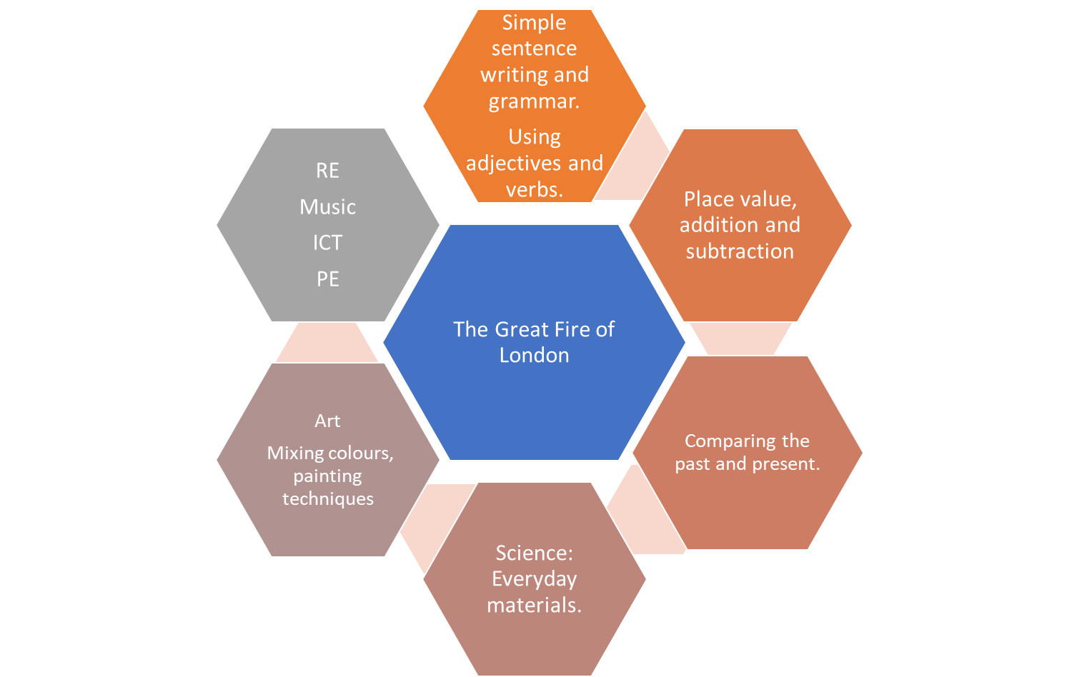
This Term’s Curriculum
Add to Text

Slide 7
We currently follow the Read Write Inc phonics scheme.
Phonics is taught for half an hour every day and children are grouped according to their phonological awareness and ability to blend and segment which may mean they are with a different teacher.
Lessons consist of a 15 minute speed sound lesson where children are introduced to a new sound which they then practise reading and writing. This is followed by a 15 minute reading lesson.
They are assessed regularly to ensure they are learning at the correct level for them.
Phonics

Slide 8
Phonics –
How you can help
Your child will shortly be bringing home a reading book and their reading diaries.
This will be the RWI book which they have been reading or have previously read in class.
Your child will already know the book they bring home as the idea is to develop fluency and their story teller voice (expression) without having to worry about decoding the words.
These books will be changed once a week on a Friday. Children will also bring home a colour band book.

Slide 9
Reading for ten to fifteen minutes every day is expected. This should be recorded in the reading record with a comment from parents and signed.
This is their homework for the week.
Children’s reading will be monitored. In school, the reading your child will do will include:
Phonics/spelling lessons
Reading in other subjects
Reading one-to-one with an adult
Reading for pleasure
Sharing a class story for fun!
Reading records must be in school daily to record this and for the teacher/LSA to check home reading.
Reading books will be changed on a Friday.
Reading

Slide 10
This term our PE units will be Football and Gym
Our PE days will be Tuesday and Thursday. (This may change due to potential external providers running PE sessions- this will be communicated via Dojo.)
Children will continue to change at school for PE so please ensure their PE kits are in school.
Please ensure that they are wearing white tops, black/navy shorts, socks, trainers or plimsolls. In colder weather, the children will be able to wear a plain black or navy tracksuit.
As usual, long hair needs to be tied back and earrings removed before coming to school.
PE

Slide 11
As a school we follow a programme for our Personal, Social, Citizenship and Health Education (PSHCE) called Jigsaw.
This is taught in every class, every week and links to assembly themes.
The Jigsaw themes for this year will be:
Being me in my World (Goals, learning, safety)
Celebrating difference (Acceptance, bullying)
Dreams and goals (Teamwork, making a difference)
Healthy me
Relationships
Changing me
Jigsaw
(PSH CE)

Slide 12
At Larkrise we have been having 'Wow days' for the last 4 years. This is something that our children really love.
Every half term we choose a day, a morning or an afternoon to do something exciting, interesting or engaging with regard to our current learning. In the past we have created castles with our parents in the hall, we have been 'Romans' for the day and come in dressed in togas and building shields and swords. The idea is to make memories for the children that help their learning to stick. Keep an eye out for dates for our upcoming Wow days later this term and next term.
Wow Days

Slide 13
Our school is increasing its focus on healthy lifestyles this year and there are some rules that will be in place.
Playtime snacks must be a piece of fruit or veg (not snack bars or chocolate or crisps).
Children will not be allowed to bring in sweets on their birthday, this is because:
It is our aim to promote healthy choices at school
We know that some parents feel under pressure to provide cakes/sweets for the whole class on their child’s birthday.
Wearing a birthday badge for the day might be a nice way of showing their friends it is their birthday.
Healthy schools

Slide 14
Mrs Maggie Pattullo is our Special Educational Needs co-ordinator. Her email address is m.pattullo@larkrise.essex.sch.uk.
If your child does not seem to be making the progress we would expect, then additional steps may need to be put into place in order to help them access the curriculum and make good progress from their starting points.
Children who require this support in addition to what they receive in the classroom will have a ‘One Plan’ outlining what they need to work on, both in and outside of school to help them make good progress.
For more significant needs, a child may have an ‘Education, Health and Care Plan’ (EHCP).
This process is always done in consultation with a child’s parents and class teacher.
Special Educational Needs and or Disabilities
(SEND)

Slide 15
Our Family Support Worker is Mel Pointon. She is one of our Safeguarding leads and also a member of the senior leadership team. Her role is to support children and families, helping to make sure that every child feels safe, listened to and supported both at school and at home.
She is trained in play therapy and counselling skills, and can support children in school through sand/play therapy, Draw and Talk, Bereavement Toolbox or simply by providing a safe space and a listening ear when they need someone to talk to.
A large part of Mel's job is supporting the parents when needed, she is experienced in supporting whatever life throws at you! To give you an idea here is a short list:
Family separation and changes within the family
Domestic abuse support
Foodbank vouchers
TPP (Trauma, Parenting and Partnership) workshops for families
Behaviour support
Helping with referrals to external agencies and services
You can meet with Mel in The Hive, a welcoming space away from the main school building where you can talk confidentially and feel at ease.
The Hive is also home to our pre-loved uniform shop, offering good-quality school uniform at a lower cost for families.
Contact Mel whether you need advice, practical support, someone to listen, or help finding the right service for your family. You don’t have to wait until a problem becomes overwhelming.
Family support worker and The Hive

Slide 16
If you have any questions/queries regarding your child/ren, their work or homework, please find me for a brief chat after school or message me via Dojo.
Please also see our Communication Policy which outlines the different ways you can contact us at school and which ways are most appropriate for different scenarios.
If you need more of my time to discuss things further, then a separate appointment will need to be made.
Questions

